Slide 1

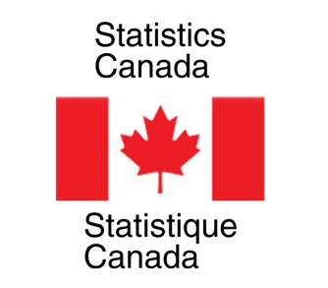

Nowcasting Macroeconomic Indicators using Google Trends
Presented By:
Aishwarya Sharma
Harpreet Kaur
Jagdeep Brar
Date: 31st May, 2022
IMAGE: https://wallpapersafari.com/w/swTjG4

Slide 2
OUTLINE
INTRODUCTION TO TEAM AND CLIENT
OVERVIEW OF PROJECT
DATA SET
METHODOLOGY
OBTAINED RESULTS
ROADBLOCKS
LEARNINGS AND FUTURE PLANS
1
2
3
4
5
6
7

Slide 3
Introduction
To Team

Slide 4
AISHWARYA SHARMA
Bachelors in Computer Science
Former Software Developer in Hewlett Packard Enterprise (HPE)
Passion for data and loves to play guitar in free time

Slide 5
JAGDEEP BRAR
Ph.D. in Applied Mathematics
Worked on Credit Risk Management Projects as
a Postdoc
Likes model fitting and cooking!!

Slide 6
HARPREET KAUR
Gold Medalist in Applied Mathematics
Former Software engineer
Love hiking, making and tinkering

Slide 7
Introduction, Motivation, Purpose, and Background
Who is your partner and what did they want from the project?
Present the "big picture" of your work, describe what the problem/research statement is and the goals of the project
Motivate the problem you are solving (why is it interesting/important), then go through a high-level description of the problem you are solving

Slide 8
Introduction
To Clients
Statistics
Canada

Slide 9

NICK NEWSTEAD
Economist, Sociologist
Data Exploration and Integration
Strong Data Science Background

Slide 10
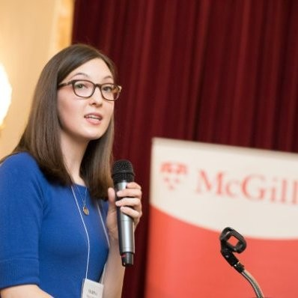
MARINA SMAILES
Senior Analyst
Data Exploration and Integration Lab
Microdata, Demographic Analysis

Slide 11

OVERVIEW OF PROJECT
Economic indicators are crucial indicators for a country`s policy and decision making but information contains a lag.
Aim to develop a model for Statistics Canada to nowcast much ahead of the actual time macroeconomic factors in real time using Google trends.
Use related queries, topics, keywords of different industrial categories to capture business cycles for economic factors.

Slide 12
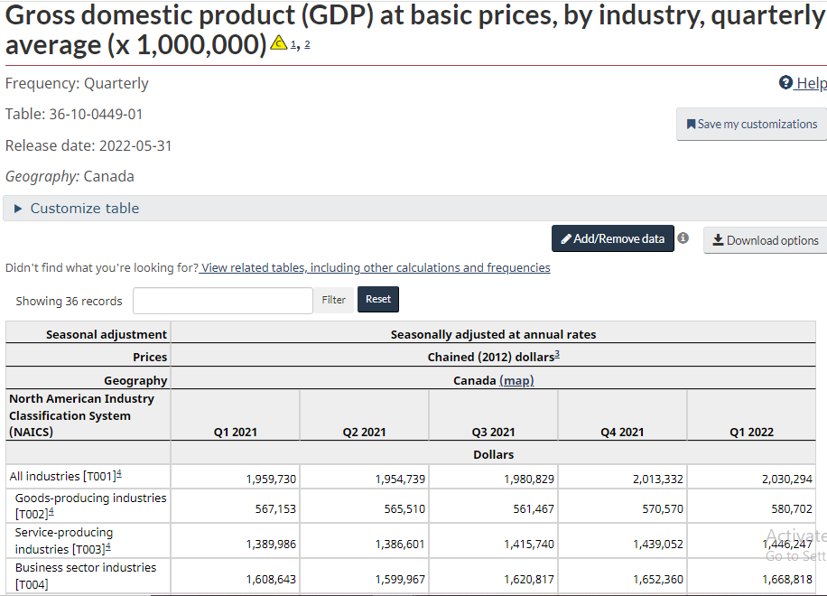

Slide 13
RESEARCH QUESTIONS
Nowcast quarterly Gross Domestic Product (GDP)
Nowcast monthly retail trade sales
Nowcast monthly retail E-commerce sales

Slide 14
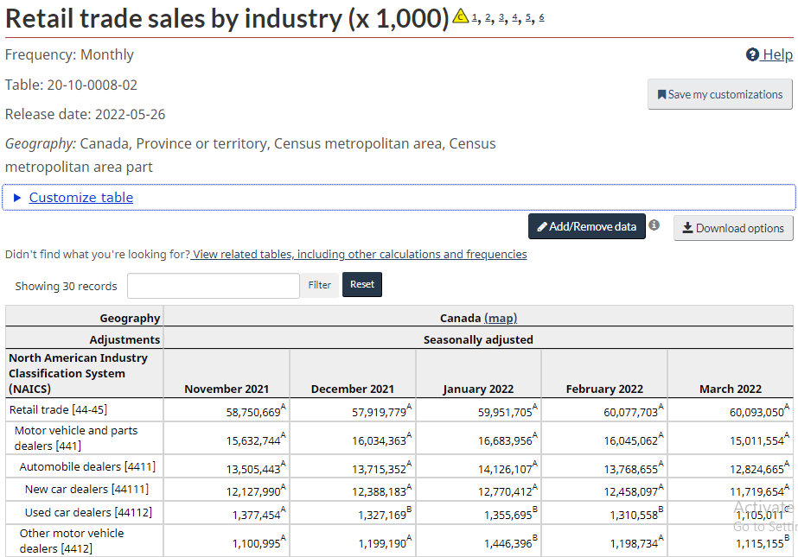

Slide 15
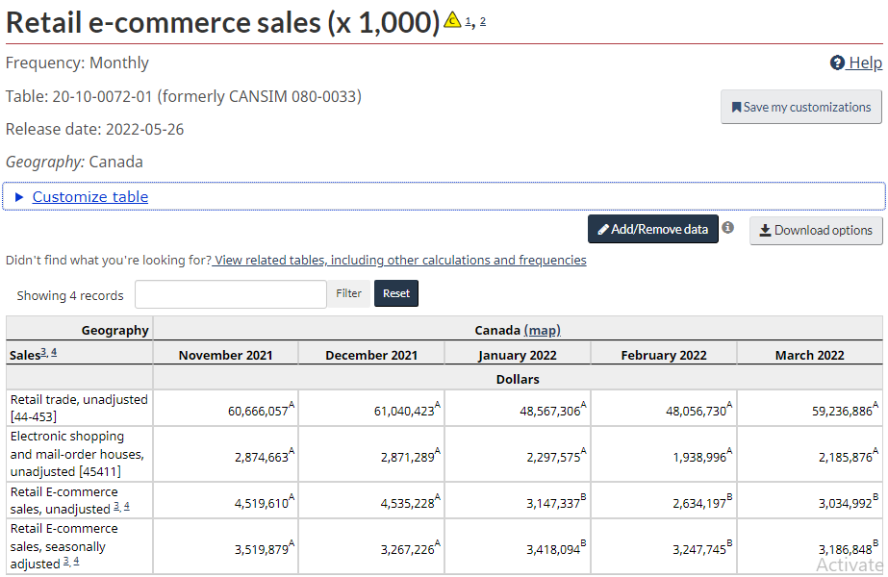

Slide 16
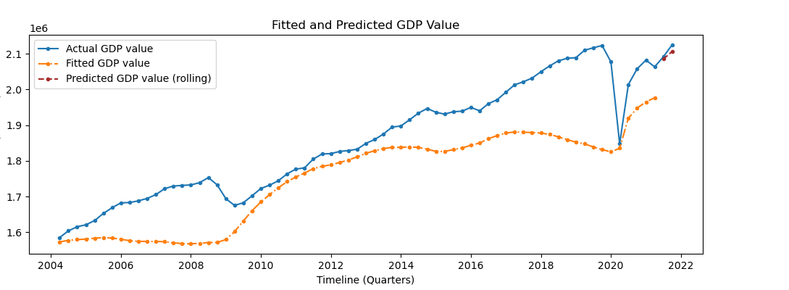
Why use Google Trends for nowcasting?
Figure _ : GDP fitted and predicted value without using Google trends

Slide 17
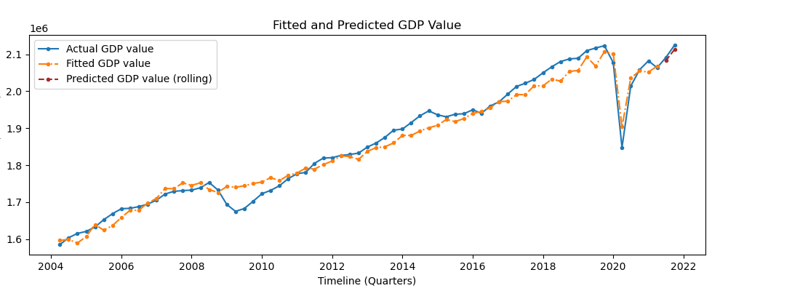
Figure _ : GDP fitted and predicted value with Google trends

Slide 18
What does nowcasting mean?
forecasts are different from the nowcasts
Nowcasting in meteorology is short-time forecasting typically referring to a horizon of +0-6h. In a practical sense now, nowcasting tends to be fast and aims at short term warnings, while NWP is complex and computationally expensive.
forecast is an estimation of a future condition.As a verb forecast is to estimate how something will be in the future.
Nowcasting is the economic discipline of determining a trend or a trend reversal objectively in real time. Nowcasting is fact-based, focuses on the known and knowable, and therefore avoids forecasting. Nowcasting is the basis of a robust decision-making process.
>NOWCASTING refers to a very short time about events...i.e. one day, two or three... based on quantitative data.
Forecasting refers to a very long future.... i.e, one year, a decade, etc. normally based on qualitative data, like Delphi, etc. But, today we have good applications based on A.I. that use quantitative data to predict the future.
> Nowcasting is more about understanding the current situation.

Slide 19
Tools, Methodology, Techniques
You will not have enough time to describe in detail all of your implementation/analysis. The goal of the presentation is to give a high-level overview project and the findings and outcomes. This is intended to convey a summary of the work completed. This section may include:
A summary and overview similar to the section in your report, with the goal of providing details of the problem you are solving
A summary of the details of your solution. It will include a presentation (or sample) of the collected data and analysis. Tables and Figures should be included as necessary.
Some specific of your project's implementation (technical details where needed and appropriate) and comments on how the project objectives were translated into a realistic work plan, utilizing team skills.

